Slide 1
Data Wrangling
Assignment 1
By Ambrish Krishna Muralitharan(S10223486G)

Slide 2
AIM
To predict the sales of each product at a particular outlet

Slide 3
Table of Content
1. Jupyter Notebook
1.1 Load Data
1.2 Missing Value Imputation
1.3 Train and Test Split
1.4 Data Preprocessing
1.5 Categorical Data Encoding
1.6 Variable Discretisation
1.7 Feature Scaling
1.8 Linear Regression Model
2. Summary
2.1 Conclusion
2.2 Improvements

Slide 4
01
Jupyter Notebook

Slide 5
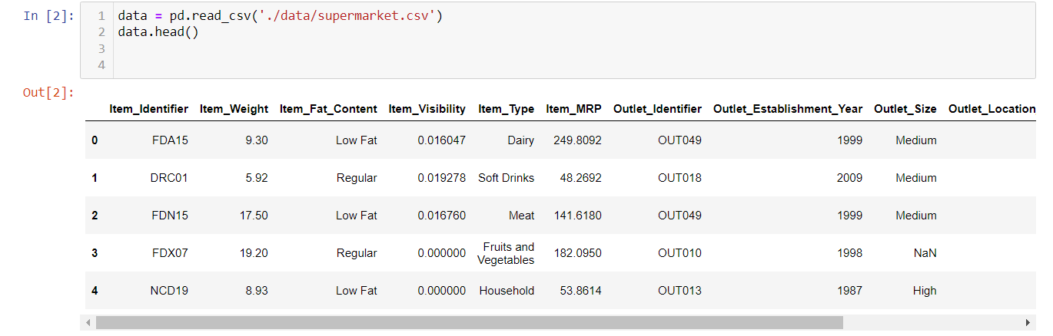
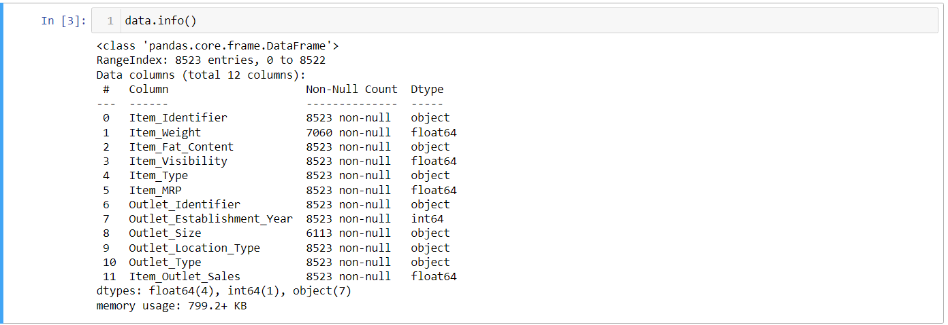
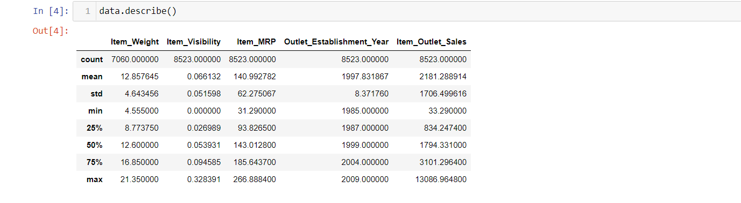
1.1 Load Data
First step for Jupyter Notebook
Functions used:-
data.head()
data.info()
data.describe

Slide 6
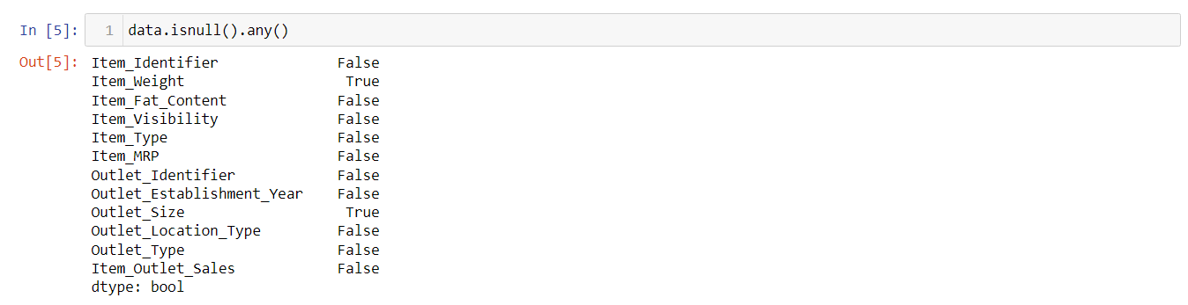
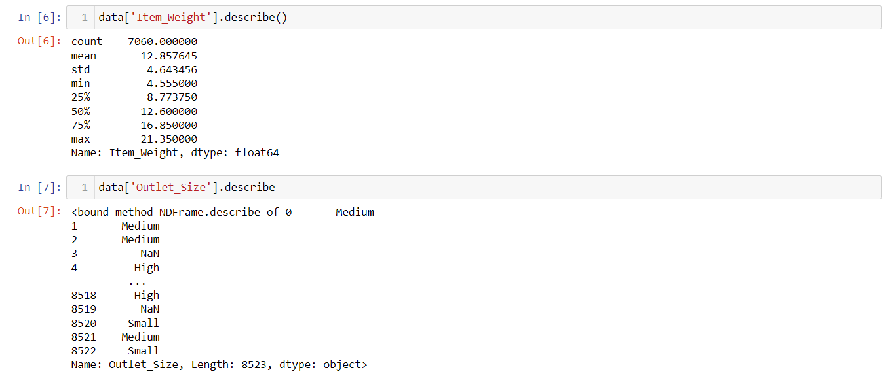
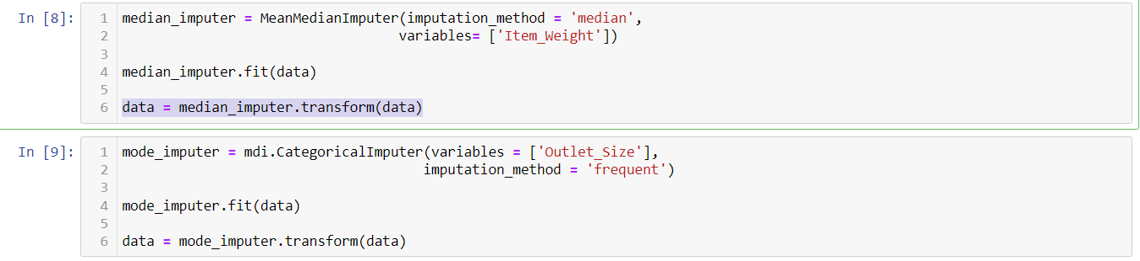
1.2 Missing Value Imputation
Check for missing values
MeanMedianImputer for numerical column
Replaces null value with median value
CategoricalImputer for categorical column
Replaces null value with most frequent value

Slide 7
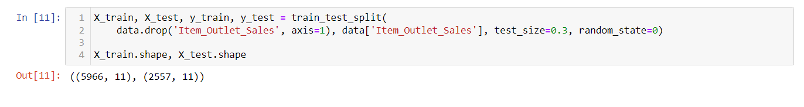
1.3 Train and Test Split
Used to help evaluate performance by splitting dataset into Train and Test sets
Train set – 70% % Test set – 30%

Slide 8
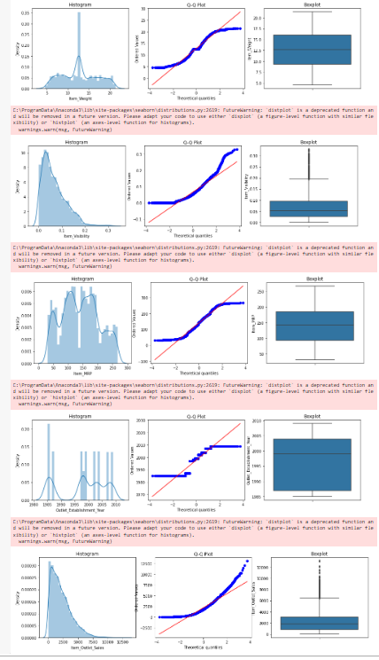
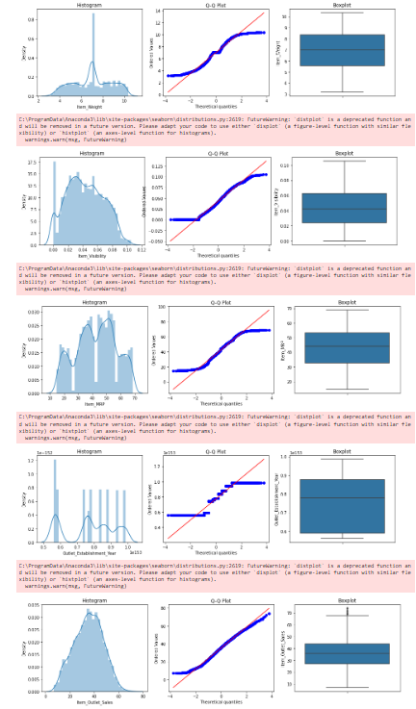
1.4 PreProcessing
Histograms, Q-Q Plot and Box Plots used for numerical variables
Histogram distribution was decent, Q-Q plot values not close to trend line, Box plot contained outliers
Used Yeo-Johnson Transformer
Histogram distribution was decent, Q-Q plot values closer to trend line, Box plot no longer contains outliers

Slide 9

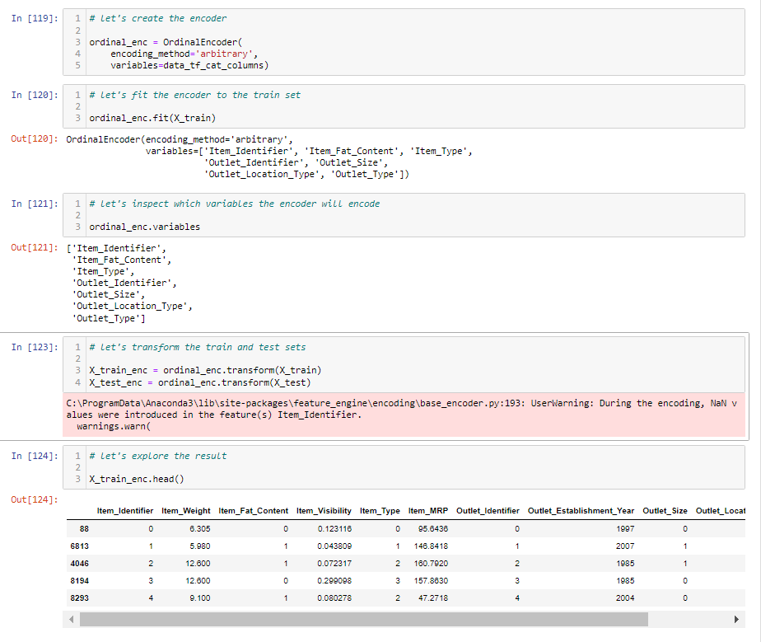
1.5 Encoding Categorical Variables
First, Identify Categorical Columns
Used Ordinal Encoder
Fitting of encoder to train set
Transformation of train and test sets

Slide 10
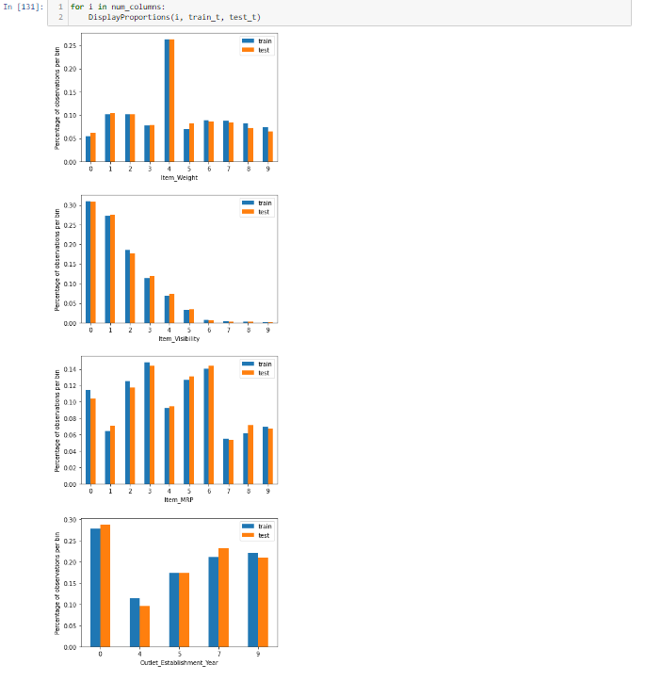
1.6 Variable Discretization/Binning
Identify Numerical Columns
Used Equal Width Discretiser
Fitting of discretiser to train set
Transformation of train and test sets
Display Proportions of each bin of each variable

Slide 11
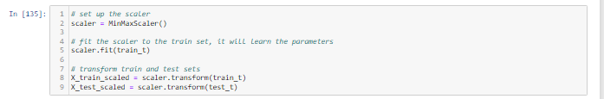
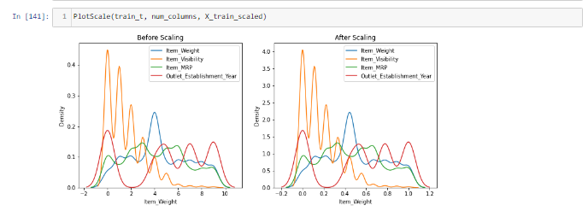
1.7 Feature Engineer
Decided between Normalisation and Standardisation
Used Normalisation(Min-Max Scaling)
Fitting of scaler to train set
Transformation of train and test sets
Plot Scales of each numerical variable before and after transformation

Slide 12
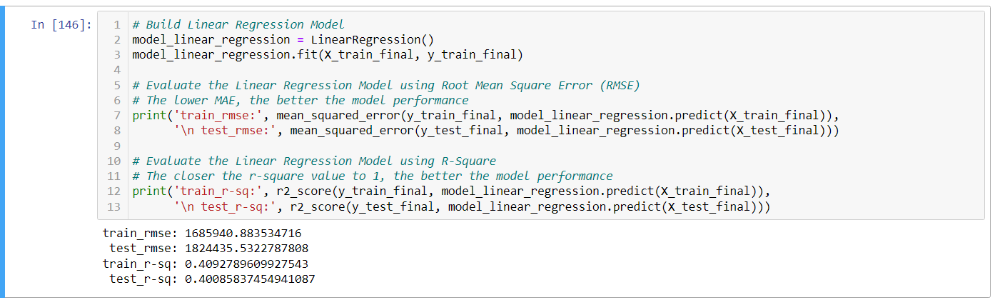
1.8 Linear Regression Model
Built and Evaluated the model
Root Mean Square Error(RMSE) and R-Square(R-SQ) were the measures used
Train RMSE: 1685941
Test RMSE: 1824436
Train R-SQ: 0.41
Test R-SQ: 0.40
Decent fit, Decent model performance

Slide 13
02
Summary

Slide 14

2.1 Conclusion
Test RMSE value was higher than Train RMSE value
Likely caused due to Overfitting
Test R-SQ value extremely similar to Train R-SQ value
Overall, Decent fit and Decent Model Performance

Slide 15
2.2 Improvements
Mathematical Computations for Feature Scaling
Overfitting
Need to make use of Math Computations for feature scaling as it can improve performance of model
Need to ensure that none of the test and train sets are overfitted as it can cause for poorer performance

